Slide 1


Presentation By Team 7
Building a LAMP Stack Web Application
15 . 10 . 2024

Slide 2
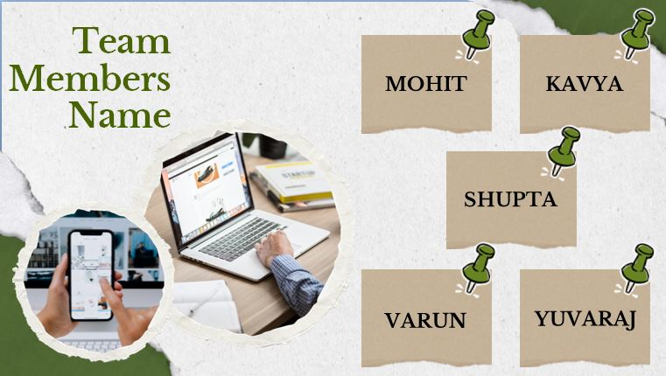

Slide 3
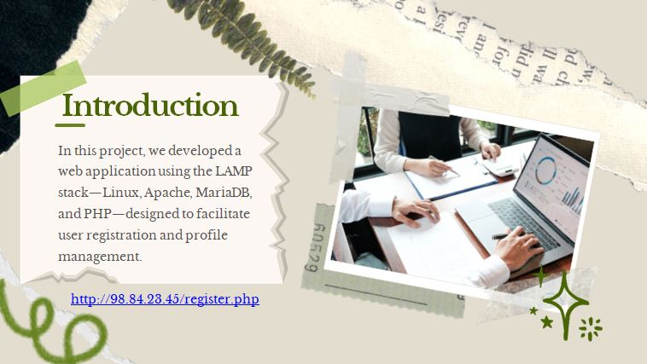

Slide 4






Definition of LAMP
Project Architecture
Development Process
Challenges Faced
Key Features of App
Today’s
Focus
Deployment on AWS
Conclusion

Slide 5
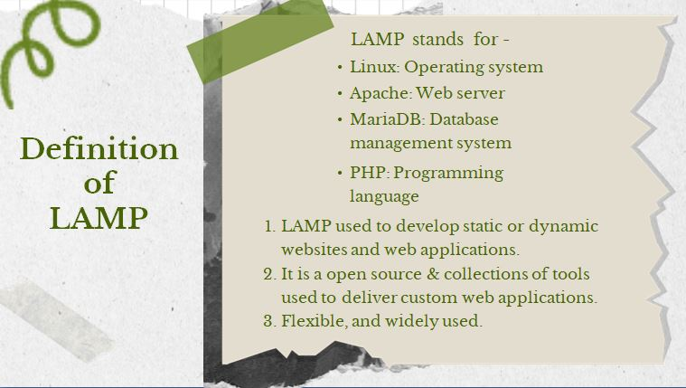

LAMP stands for -
Linux: Operating system
Apache: Web server
MariaDB: Database management system
Definition
of
LAMP
PHP: Programming language
LAMP used to develop static or dynamic
websites and web applications.
2. It is a open source & collections of tools
used to deliver custom web applications.
3. Flexible, and widely used.

Slide 6
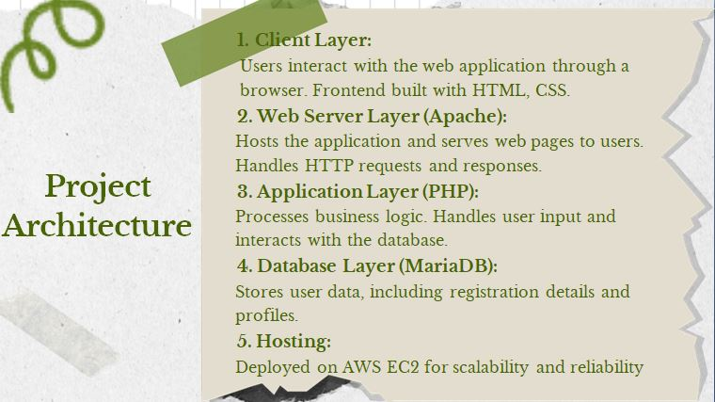

Slide 7
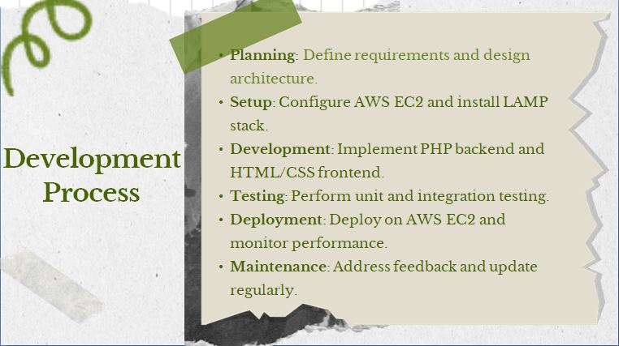

Slide 8
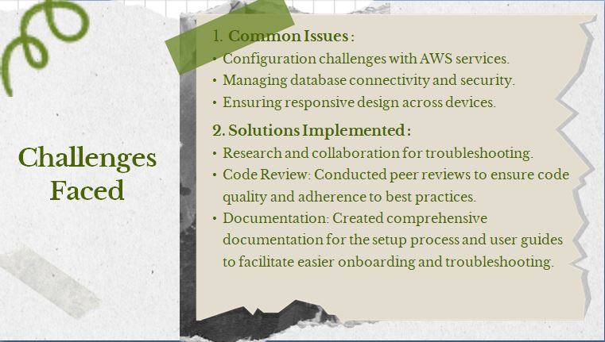

Slide 9
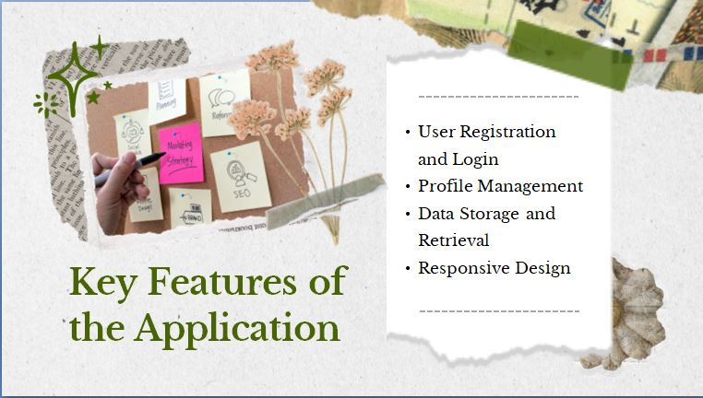

Slide 10
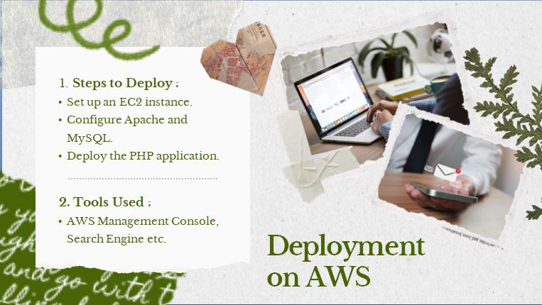

Slide 11
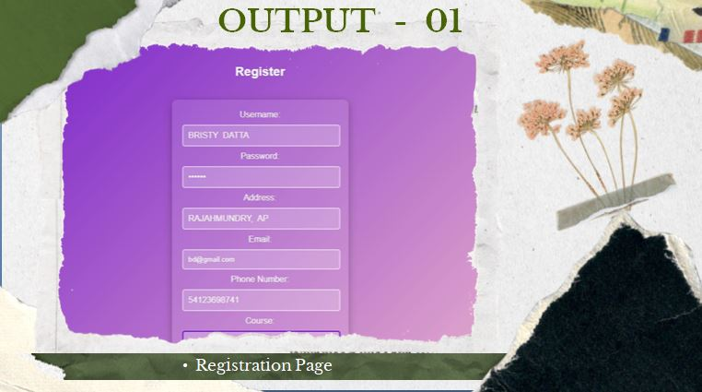
Registration Page

Slide 12
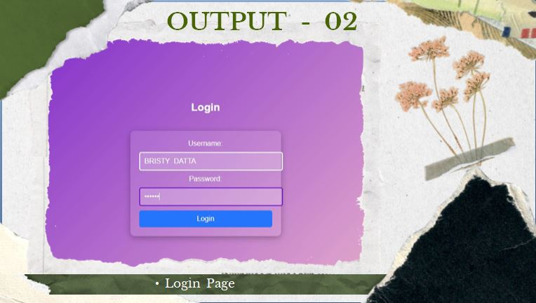
Login Page

Slide 13
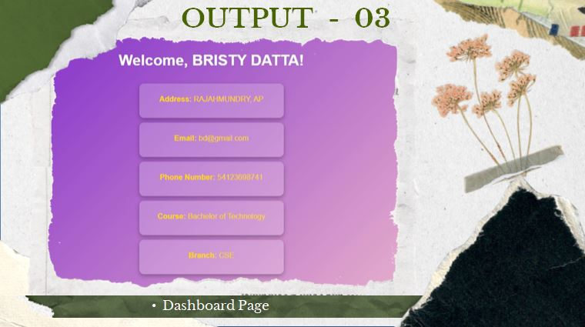
Dashboard Page

Slide 14
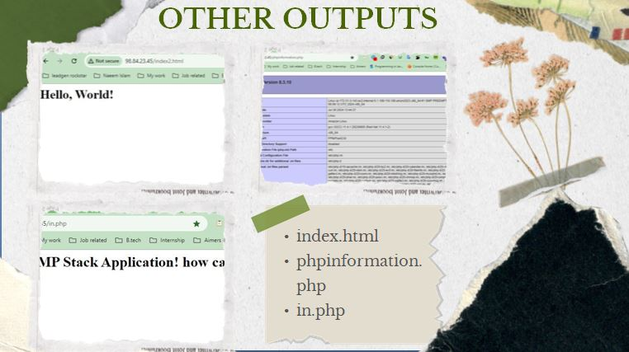

Slide 15
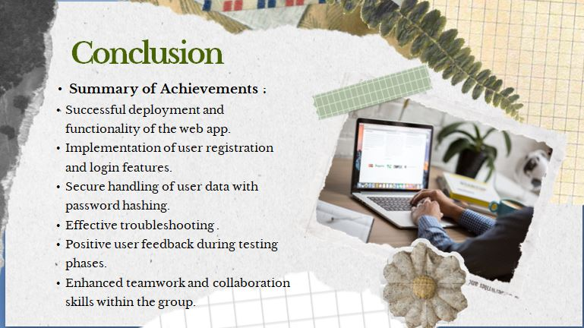

Slide 16


